Slide 1
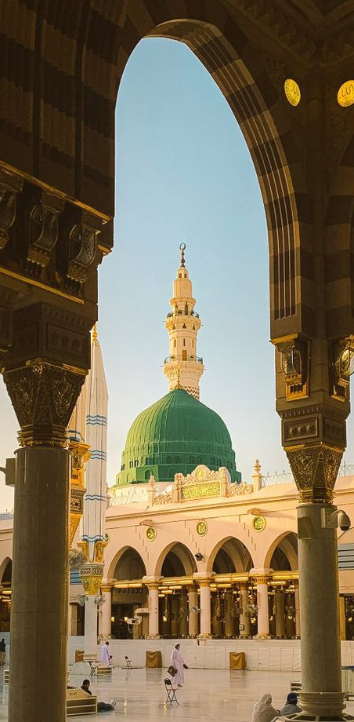
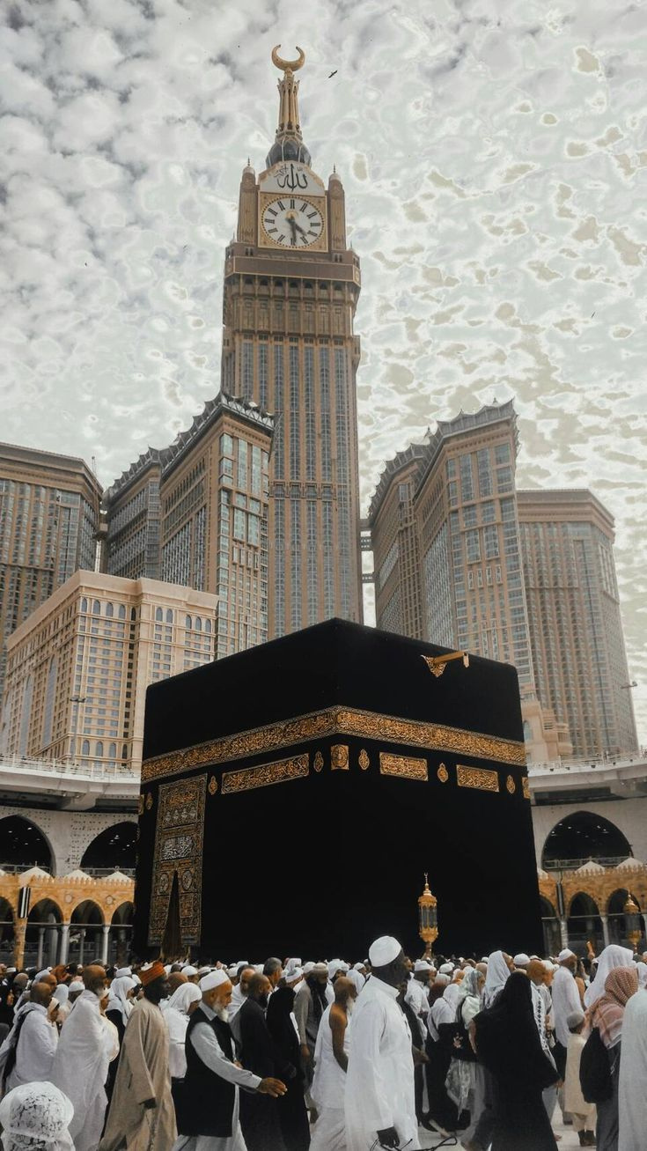
ZAMZAM DISPENSER MONITORING
Course Project – Semester I (Fall 2023 - 2024)
CS487 - Internet of Things
Team Members:
Abeer Osman | 4010368
Salwa Shama | 4010405
Sana Shama | 4010404
Instructor:
Prof. Mohamed Zayed

Slide 2
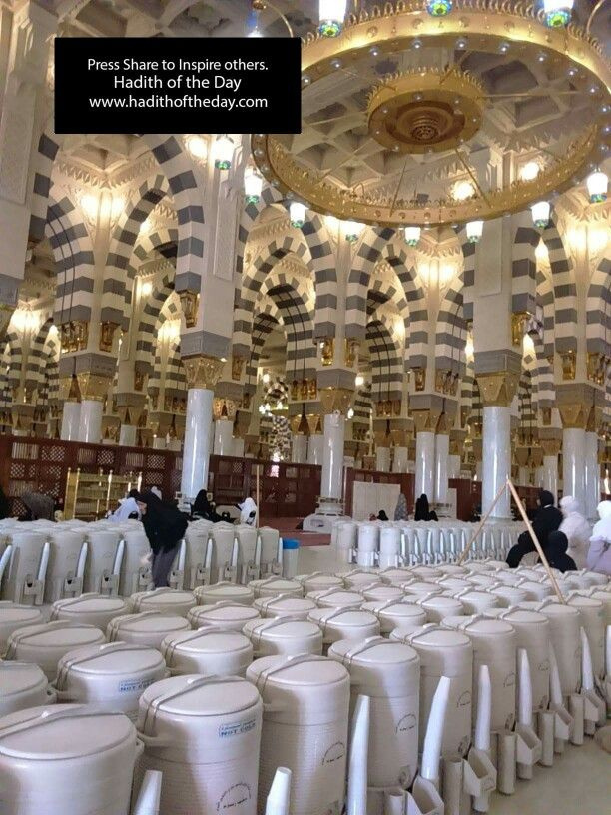
PROBLEM STATEMENT
The problems that we aim to address are the manual checking and hourly tours required to monitor and replace Zamzam containers. This process consumes valuable manpower that could be utilized more efficiently. By implementing an automated monitoring system with real-time data updates and visual alerts, we can optimize resource allocation and streamline the management of water levels.

Slide 3
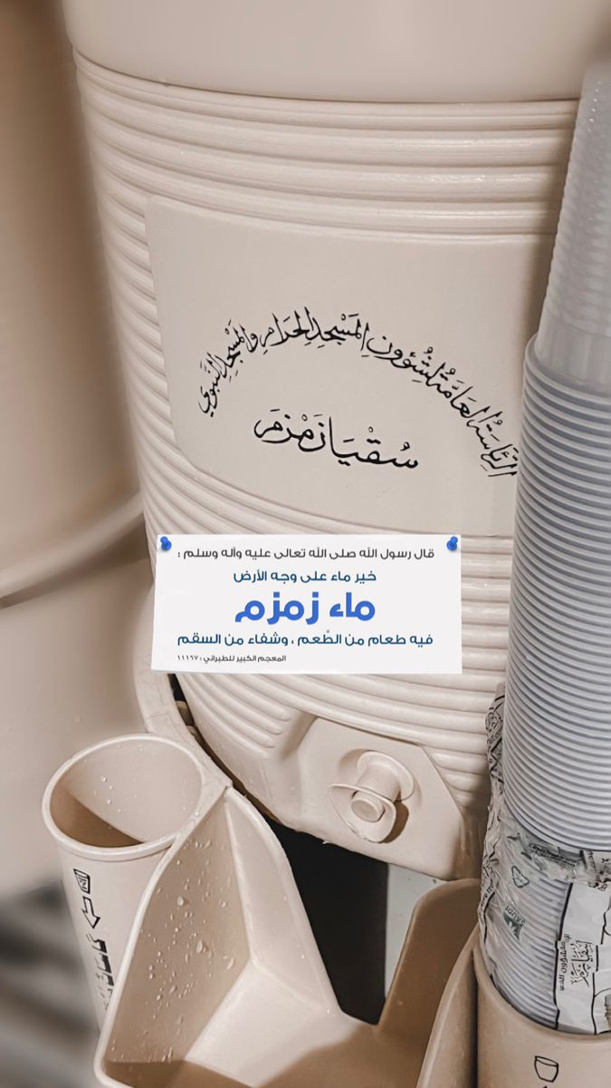
PROJECT DESCRIPTION
This project aims to establish a comprehensive monitoring system for water levels in containers situated at Al Haramain, Al-Masajid Haram, and Al-Masajid a Nabawi, with a specific focus on Zamzam water.

Slide 4
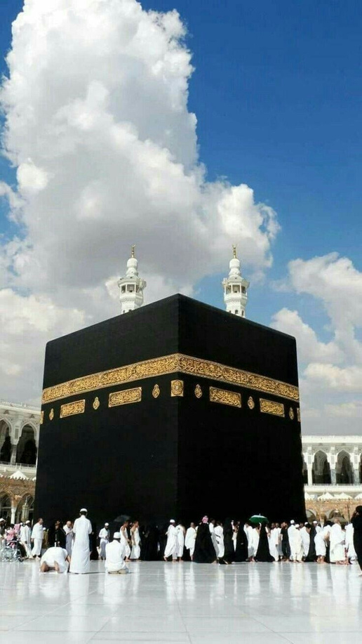
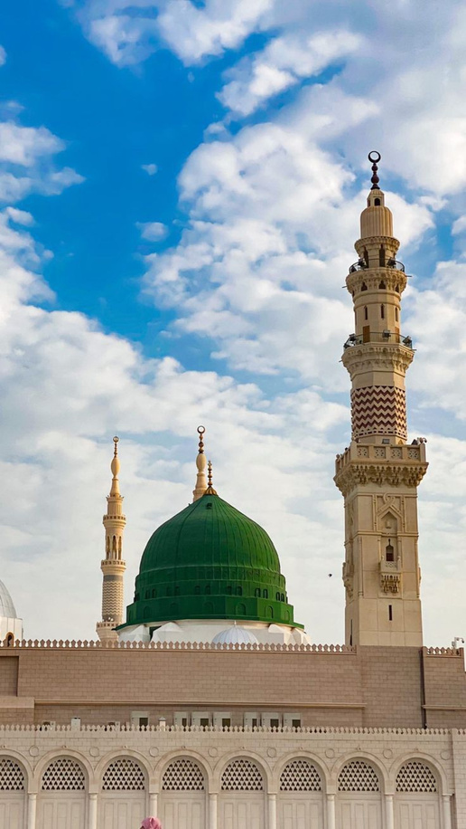
MASJID AL-HARAM
MAKKAH
TARGET USERS
Al Masjid an Nabawi
MADINAH

Slide 5
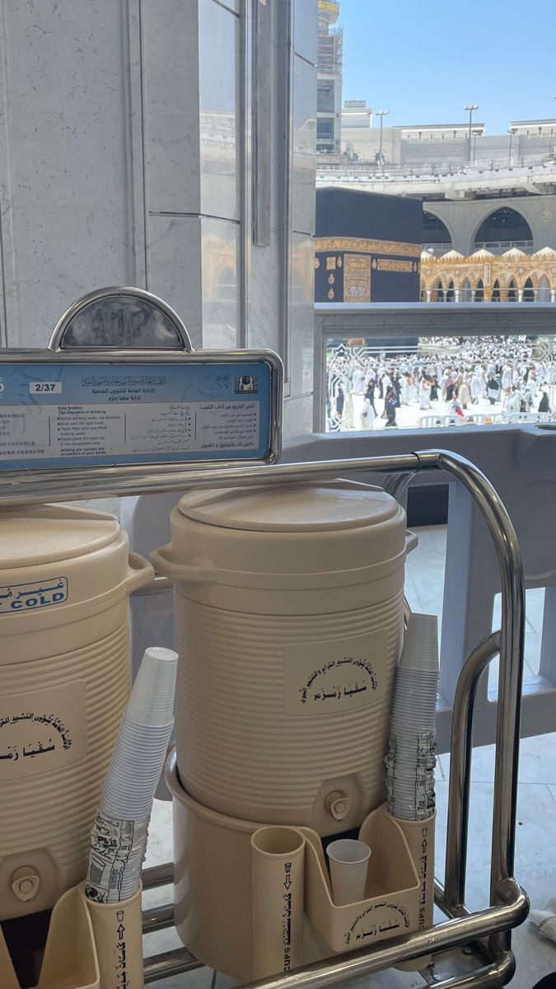
PROJECT GOALS
Implement an automated monitoring system
Enable real-time data updates
Provide visual alerts for water level thresholds
Develop a web page dashboard

Slide 6
PROJECT BENEFITS
6benefits

Slide 7



OPTIMIZE RESOURCE ALLOCATION
DATA-DRIVEN DECISION MAKING
ENHANCED VISITOR EXPERIENCE
NOTE: THERE ARE OTHER BENEFITS MENTIONED IN THE REPORT

Slide 8
PROJECT REQUIREMENTS

Slide 9
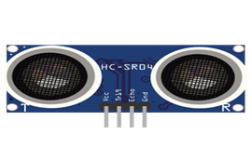
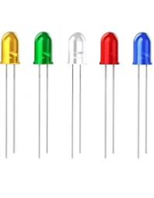


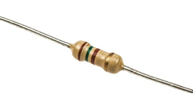

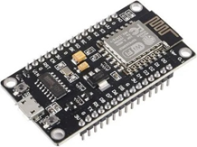
Project Requirements
Hardware Requirements
Software Requirements
Ultrasonic Sensor
LEDs
Firebase
Arduino
ESP8266
Resistors
Web Technolgies

Slide 10
SYSTEM ARCHITECTURE

Slide 11
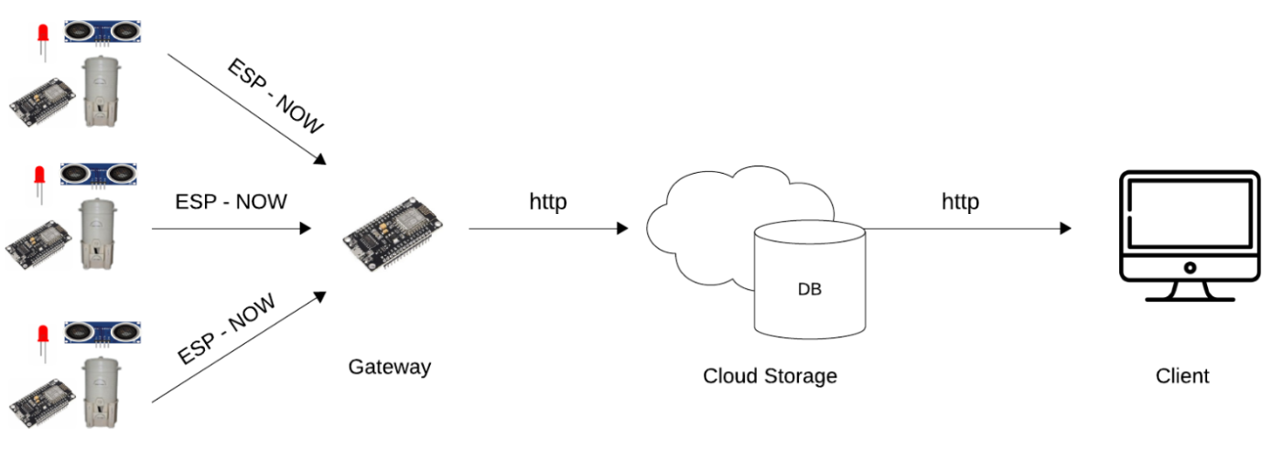
System Architecture

Slide 12
THANK You

